Slide 1



Data-driven Laser Powder Bed Fusion distortion prediction using geometric parameters
Pablo Luna
Mentor: Dr. Hannah Budinoff
Arizona NASA Space Grant Statewide Symposium
April 22nd , 2023

Slide 2
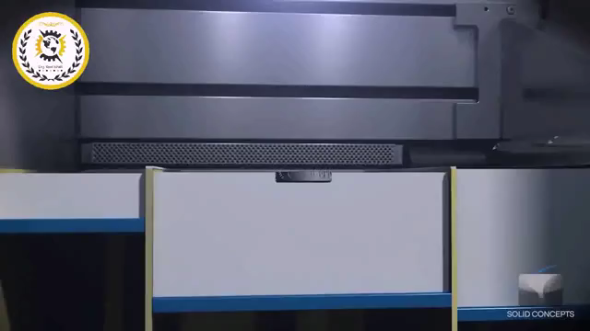
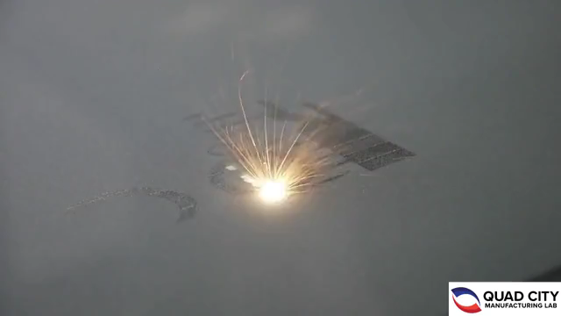

What is Laser Powder Bed Fusion?
Laser Powder Bed Fusion (LPBF) is an additive manufacturing process consisting of the layer-by-layer stacking of fused metal powder.
LPBF is commonly used in the aerospace industry due to the need of generating complex geometries for lightweight components.
Source: gfycat.com

Slide 3
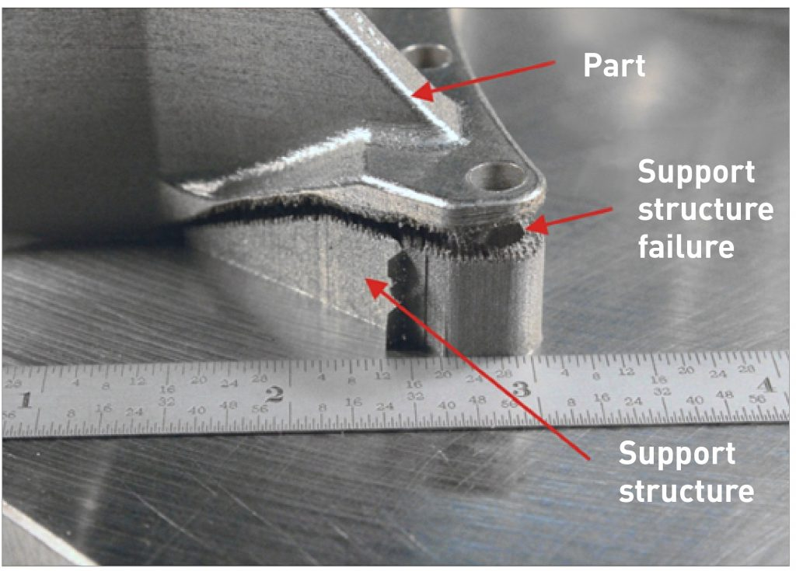
Challenges with Laser Powder Bed Fusion
Significant residual stress during the printing process causes distortion
LPBF parameters influences defect formation.
Trial-and-error analysis with simplistic part geometry variations of used for optimal parameter searching.
These methods are unlikely to be optimal for complex geometries.
Source: metal-am.com

Slide 4
Objective
With a data driven model…
Predict distortion based on geometry alone
Increase dimensional accuracy
Enable rapid certification of additive manufactured parts
By understanding relationships between part geometries and printing parameters we can increase accuracy of models for distortion prediction

Slide 5
Research Question
Is there a significant correlation between geometric parameters and maximum distortion?

Slide 6
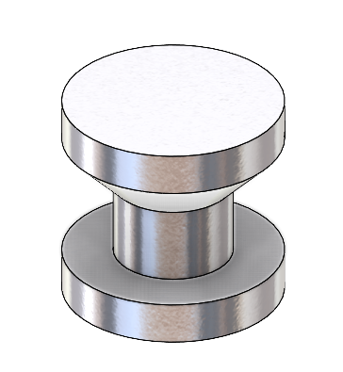
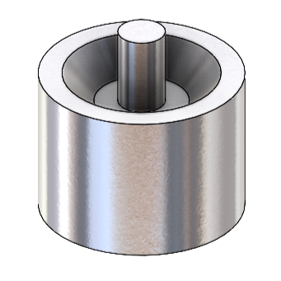
Methods
We created 324 3D axisymmetric self-supporting models in SolidWorks
Designs were categorized into three sizes
All parts were designed with the LPBF guideline's limitations in mind (i.e., minimum wall thickness, overhang angles <45°)
3D Models
Cross Sections

Slide 7
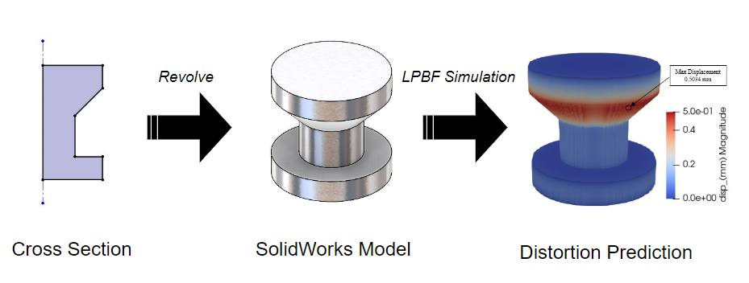
Maximum distortion magnitude was obtained using ANSYS Additive Print thermal strain simulations.
We used constant machine parameters for all simulations
Max Distortion: 0.5034 mm

Slide 8
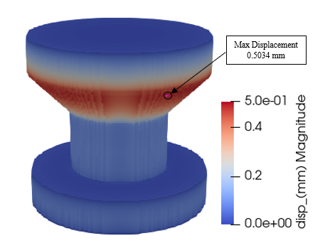
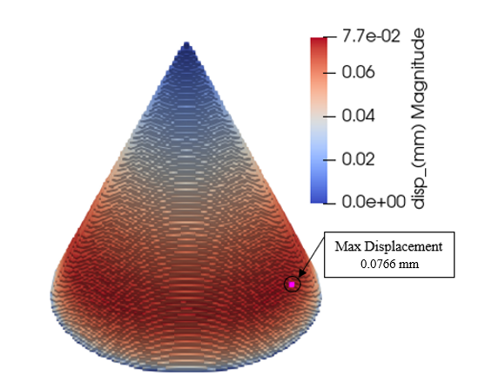
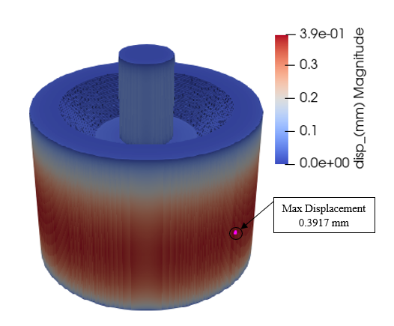
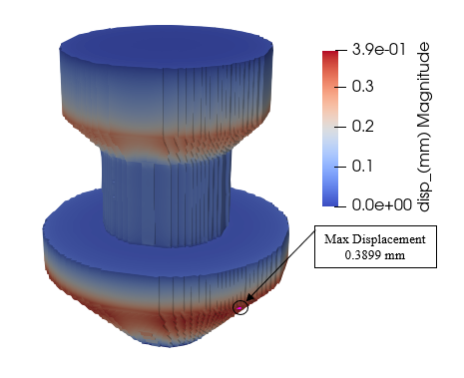
Max Distortion: 0.5034 mm
Max Distortion: 0.0766 mm
Max Distortion: 0.3917 mm
Max Distortion: 0.3899 mm

Slide 9
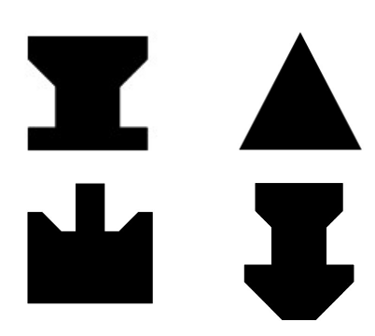
Geometry parameters considered
Cross sectional Area
Cross sectional Perimeter
Surface area
Volume
Center of mass (z-axis)

Slide 10
Scatter plots
Distortion vs Center of mass is closer to a monotonic relationship

Slide 11
Second trendline forming

Slide 12
Results
 | Cross Section area | Cross Section Perimeter | Volume | Surface Area | Center of Mass (z-axis)
Coefficient (Rs) | 0.54 | 0.23 | 0.45 | 0.34 | 0.70
P value | 3.12E-26 | 1.85E-05 | 1.57E-17 | 2.10E-10 | 1.37E-49
Spearman’s Rank Correlation Coefficient (Rs) was used to determine the strength of relationship
Cross Section Perimeter had the weakest positive correlation with maximum distortion
Center of mass had the strongest positive correlation with maximum distortion
Miniscule P values means we can neglect null hypothesis (Correlation is not due to chance)

Slide 13
Implications and Future work
Minimizing center of mass in the z-axis tends to decrease distortion.
Our findings provide direct guidance for mechanical designers to minimize distortion.
Future work
Identify more correlated geometric parameters with a ML regression model using cross section images
Expand our dataset to non-axisymmetric geometries
Jannatul Bushra, Hannah D. Budinoff, Pablo Luna, Marat Latypov, “Towards Data-Driven Guidance for Metal Powder Bed Fusion”, submitted to the ASME IDETC 2023 Conference.

Slide 14
Acknowledgments
I would like to express my gratitude to…
My mentor Dr. Hannah Budinoff
Graduate student Jannatul Bushra
Arizona/NASA Space Grant Consortium
The University of Arizona

Slide 15
Thank you!

